Slide 1
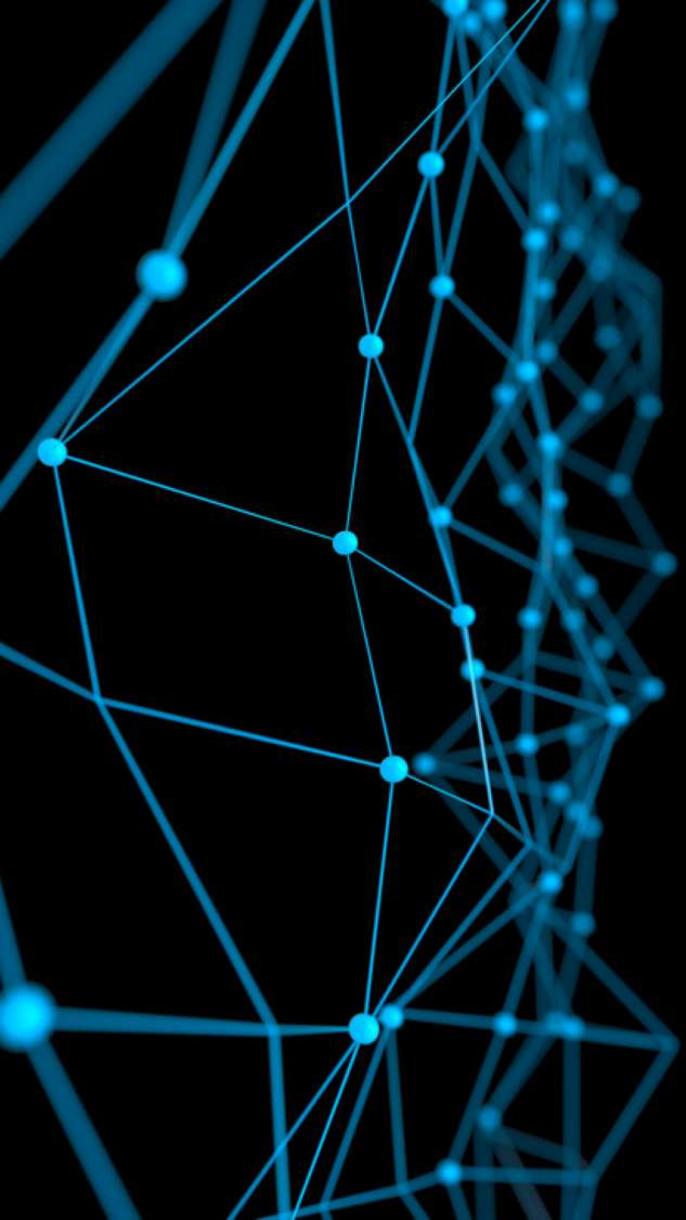
Deep Learning for Computer Vision
Convolution Neural Network: Advance
Rang Nguyen
June 2019

Slide 2
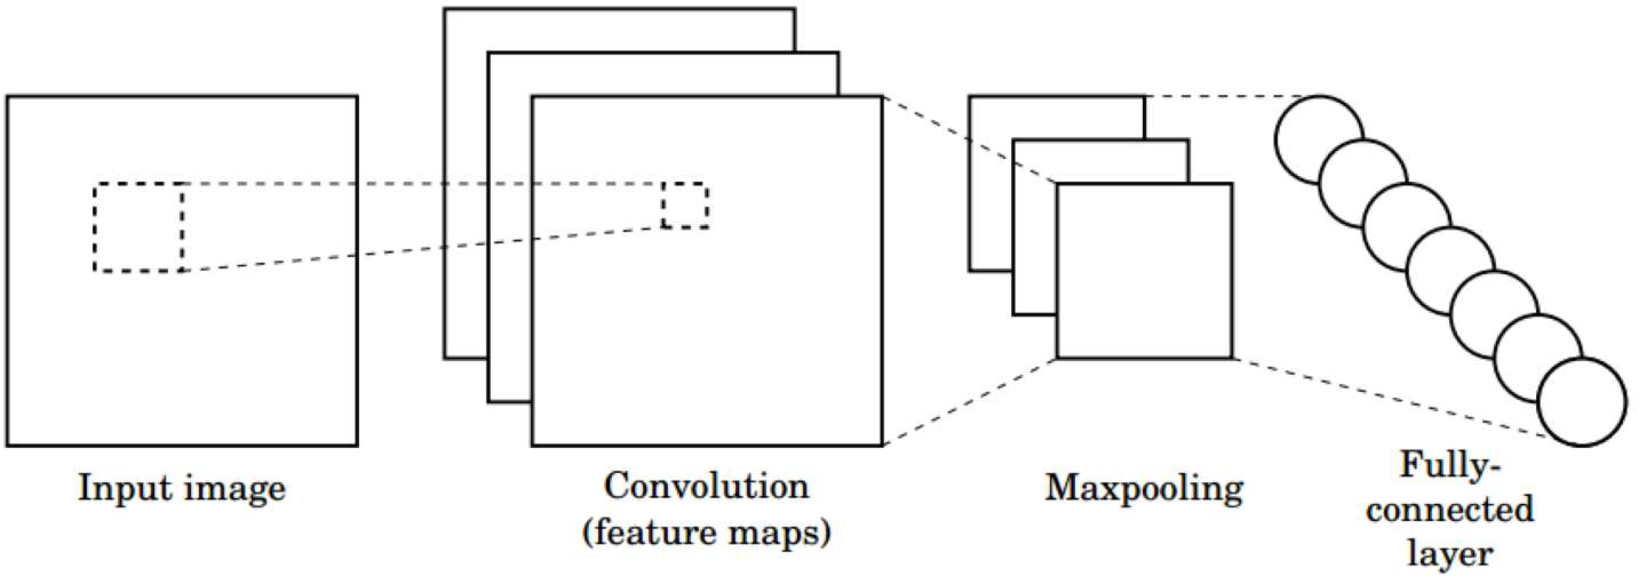
CNNs for Classification
Convolution: Apply filters with learned weights to generate feature maps.
Non-linearity: Often ReLU.
Pooling: Downsampling operation on each feature map.
Train model with image data.
Learn weights of filters in convolutional layers.
1/29/19

Slide 3
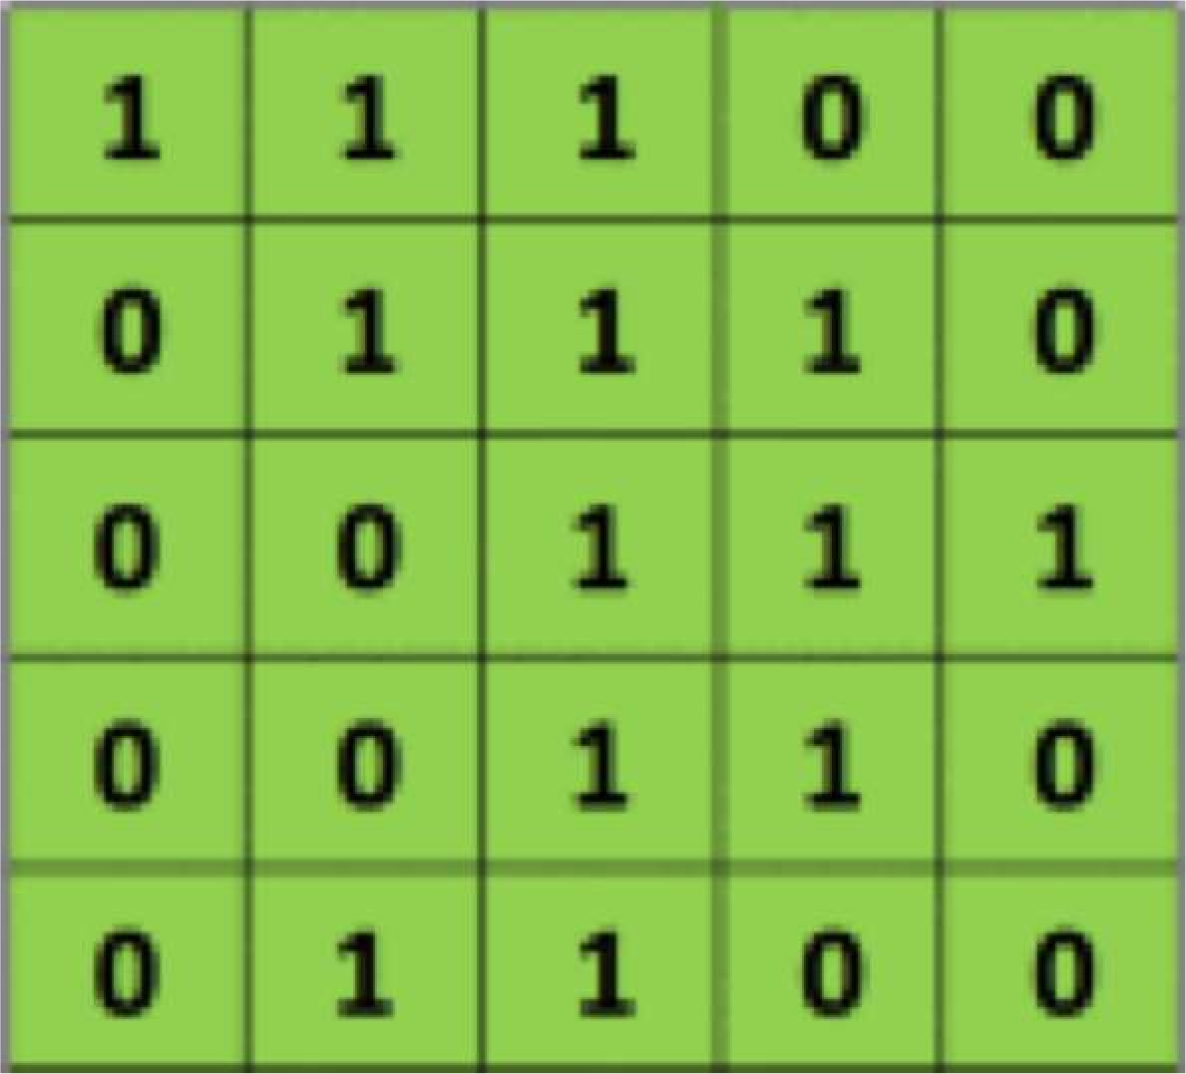
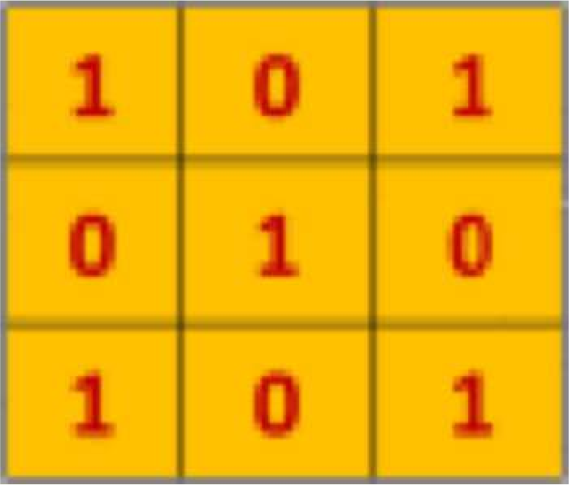
Convolution Layer
Suppose we want to compute the convolution of a 5x5 image and a 3x3 filter:
filter
image
We slide the 3x3 filter over the input image, element-wise multiply, and add the outputs…
[5] 1/29/19

Slide 4
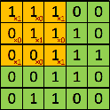
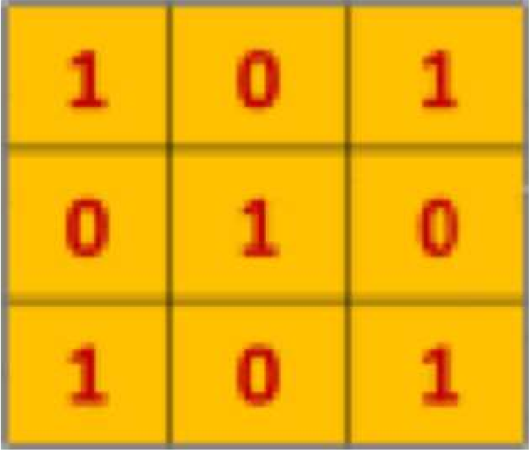
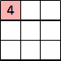
Convolution Layer
We slide the 3x3 filter over the input image, element-wise multiply, and add the outputs:
filter
feature map
[5] 1/29/19

Slide 5
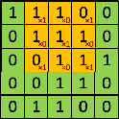
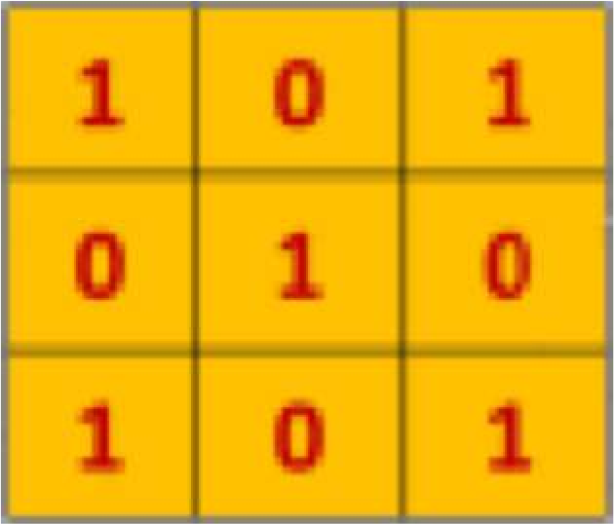
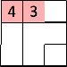
Convolution Layer
We slide the 3x3 filter over the input image, element-wise multiply, and add the outputs:
filter
feature map
[5] 1/29/19

Slide 6
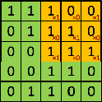
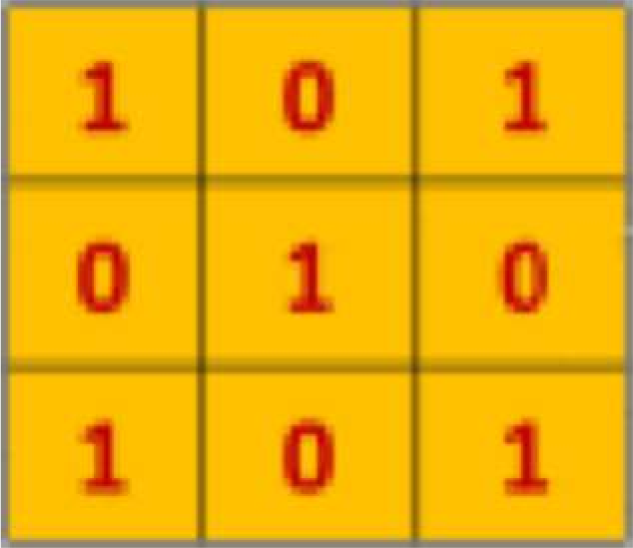
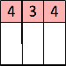
Convolution Layer
We slide the 3x3 filter over the input image, element-wise multiply, and add the outputs:
filter
feature map
[5] 1/29/19

Slide 7
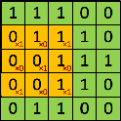
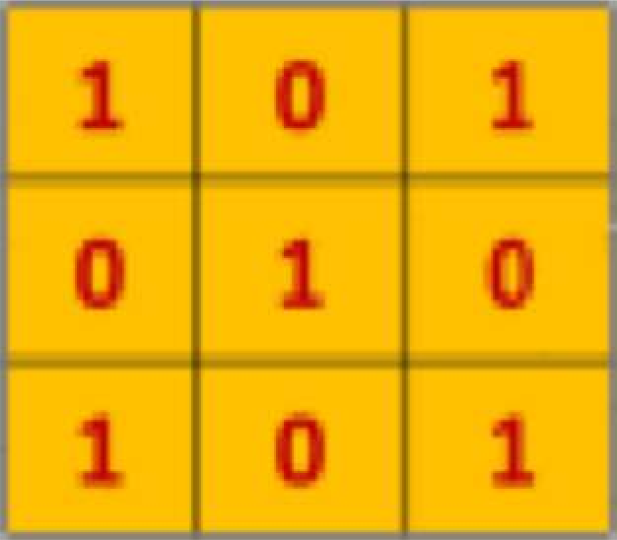
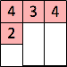
Convolution Layer
We slide the 3x3 filter over the input image, element-wise multiply, and add the outputs:
filter
feature map
[5] 1/29/19

Slide 8
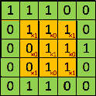
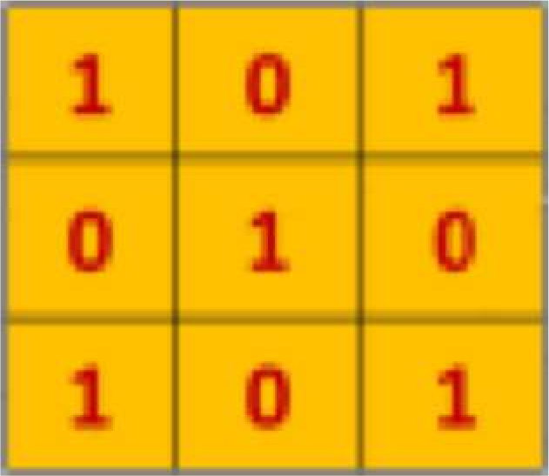
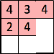
Convolution Layer
We slide the 3x3 filter over the input image, element-wise multiply, and add the outputs:
filter
feature map
[5] 1/29/19

Slide 9
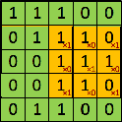
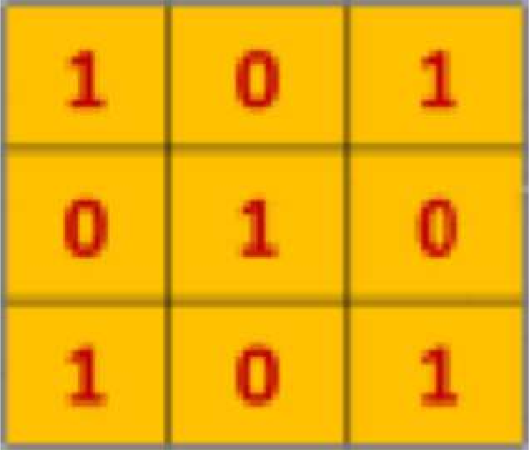
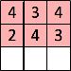
Convolution Layer
We slide the 3x3 filter over the input image, element-wise multiply, and add the outputs:
filter
feature map
[5] 1/29/19

Slide 10
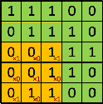
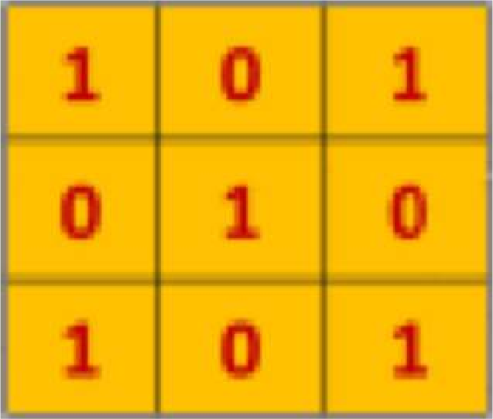
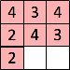
Convolution Layer
We slide the 3x3 filter over the input image, element-wise multiply, and add the outputs:
filter
feature map
[5] 1/29/19

Slide 11
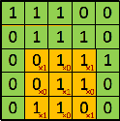
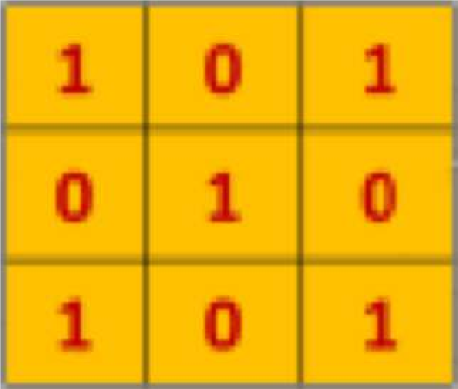
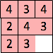
Convolution Layer
We slide the 3x3 filter over the input image, element-wise multiply, and add the outputs:
filter
feature map
[5] 1/29/19

Slide 12
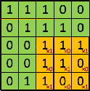
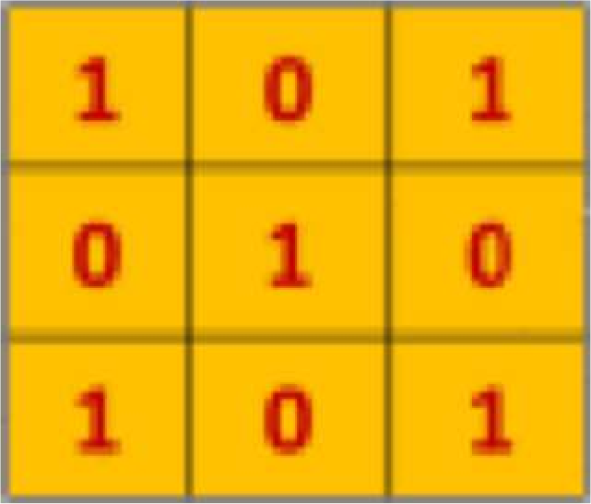
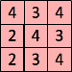
Convolution Layer
We slide the 3x3 filter over the input image, element-wise multiply, and add the outputs:
filter
feature map
[5] 1/29/19

Slide 13
Pooling layer
Single depth slice
1 | 1 | 2 | 4
5 | 6 | 7 | 8
3 | 2 | 1 | 0
1 | 2 | 3 | 4
x
max pool with 2x2 filters and stride 2
6 | 8
3 | 4
Reduced dimensionality
Spatial invariance
y
How else can we downsample and preserve spatial invariance?
[3] 1/29/19

Slide 14
CNNs for Classification: ImageNet

Slide 15
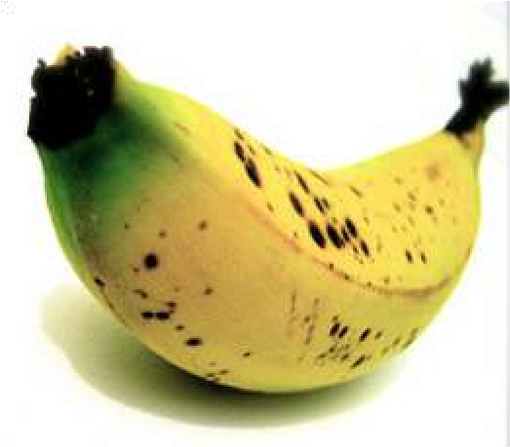
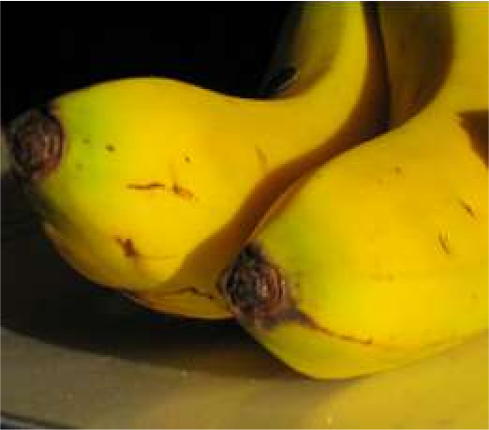
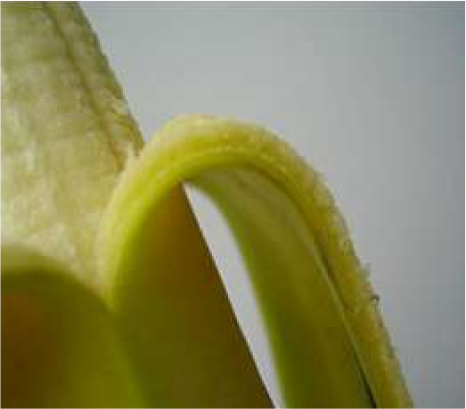
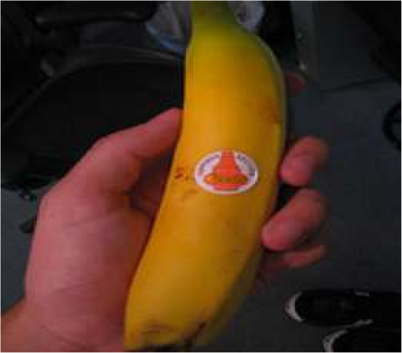
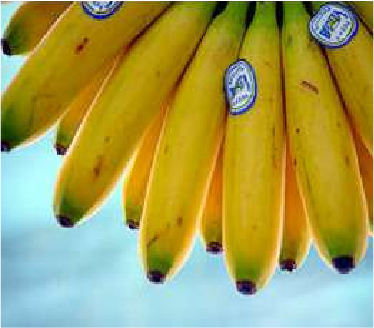
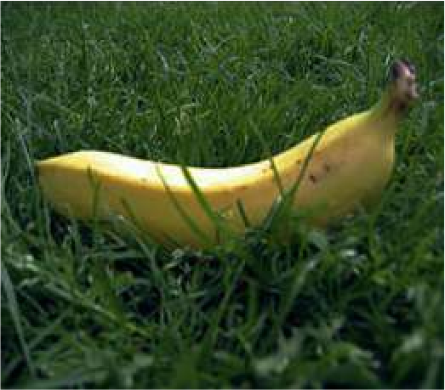
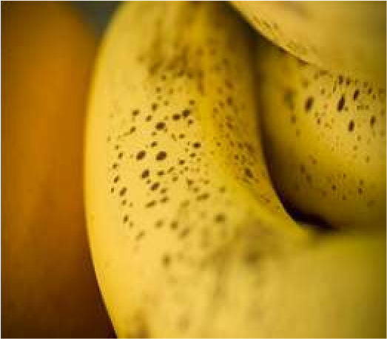
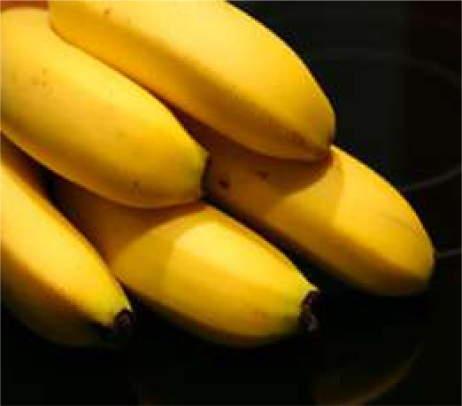
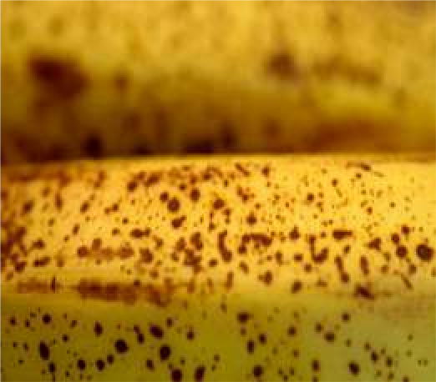
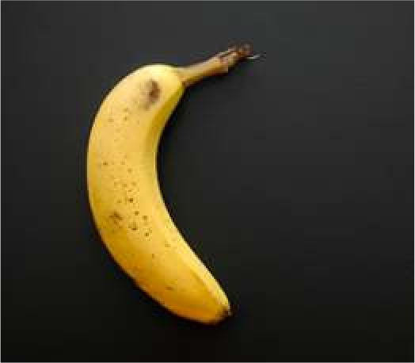
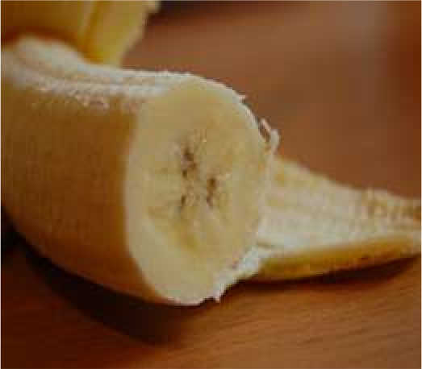
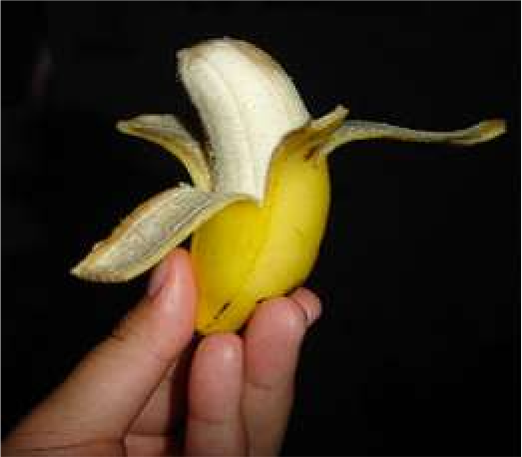
ImageNet Dataset
Dataset of over 14 million images across 21,841 categories
“Elongated crescent-shaped yellow fruit with soft sweet flesh”
1409 pictures of bananas.

Slide 16

ImageNet Challenge
Classification task: produce a list of object categories present in image. 1000 categories. “Top 5 error”: rate at which the model does not output correct label in top 5 predictions
Other tasks include:
single-object localization, object detection from video/image, scene classification, scene parsing

Slide 17
ImageNet Challenge: Classification Task
30
28.2
2012: AlexNet. First CNN to win.
8 layers, 61 million parameters
2013: ZFNet
8 layers, more filters
2014: VGG
19 layers
2014: GoogLeNet
“Inception” modules
22 layers, 5million parameters
2015: ResNet
152 layers
25.8
classification error %
20
16.4
11.7
10
6.7
5.1
3.57
0
2010
2011
2012
2013
2014
2015
Human

Slide 18
ImageNet Challenge: Classification Task
30
28.2
25.8
150
classification error %
number of layers
20
100
16.4
11.7
10
50
7.3
6.7
5.1
3.57
0
0
2010
2011
2012
2013
2014
2014
2015
Human
2010
2011
2012
2013
2014
2014
2015

Slide 19
An Architecture for Many Applications

Slide 20
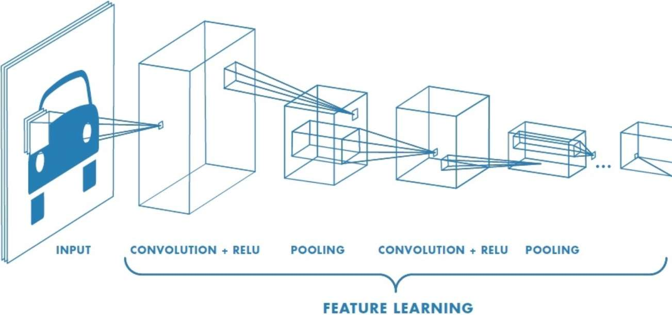
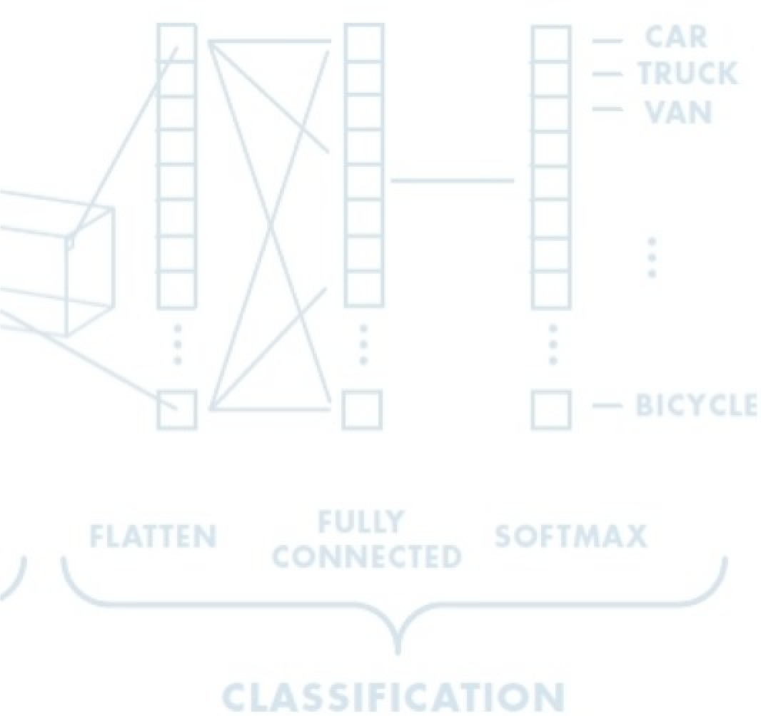
An Architecture for Many Applications
Object detection with R-CNNs Segmentation with fully convolutional networks
Image captioning with RNNs

Slide 21
Case Study: AlexNet

Slide 22
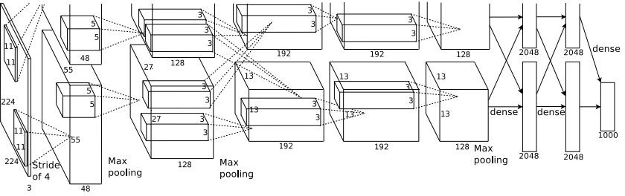
Case Study: AlexNet
[Krizhevsky et al. 2012]
Architecture:
CONV1 MAX POOL1 NORM1 CONV2 MAX POOL2 NORM2 CONV3 CONV4 CONV5
Max POOL3 FC6
FC7 FC8
Lecture 9 - 22

Slide 23
Case Study: AlexNet
[Krizhevsky et al. 2012]
Input: 227x227x3 images
First layer (CONV1): 96 11x11 filters applied at stride 4
=>
Q: what is the output volume size?
Hint: (227-11)/4+1 = 55
Lecture 9 - 23
Fei-Fei Li & Justin Johnson & Serena Yeung Lecture 9 - May 2, 2017

Slide 24
Case Study: AlexNet
[Krizhevsky et al. 2012]
Input: 227x227x3 images
First layer (CONV1): 96 11x11 filters applied at stride 4
=>
Output volume [55x55x96]
Q: What is the total number of parameters in this layer?
A: (11*11*3+1)*96 = 35K
Lecture 9 - 24
Fei-Fei Li & Justin Johnson & Serena Yeung Lecture 9 - May 2, 2017

Slide 25
Case Study: AlexNet
[Krizhevsky et al. 2012]
Input: 227x227x3 images After CONV1: 55x55x96
Second layer (POOL1): 3x3 filters applied at stride 2 Q: what is the output volume size?
A: (55-3)/2+1 = 27
Lecture 9 - 25
Fei-Fei Li & Justin Johnson & Serena Yeung Lecture 9 - May 2, 2017

Slide 26
Case Study: AlexNet
[Krizhevsky et al. 2012]
Input: 227x227x3 images After CONV1: 55x55x96
Second layer (POOL1): 3x3 filters applied at stride 2 Output volume: 27x27x96
Q: what is the number of parameters in this layer?
A: 0
Lecture 9 - 26
Fei-Fei Li & Justin Johnson & Serena Yeung Lecture 9 - May 2, 2017

Slide 27
Case Study: AlexNet
[Krizhevsky et al. 2012]
Input: 227x227x3 images After CONV1: 55x55x96 After POOL1: 27x27x96
...
Lecture 9 - 27
Fei-Fei Li & Justin Johnson & Serena Yeung Lecture 9 - May 2, 2017

Slide 28
Case Study: AlexNet
[Krizhevsky et al. 2012]
Full (simplified) AlexNet architecture: [227x227x3] INPUT
[55x55x96] CONV1: 96 11x11 filters at stride 4, pad 0 [27x27x96] MAX POOL1: 3x3 filters at stride 2 [27x27x96] NORM1: Normalization layer
[27x27x256] CONV2: 256 5x5 filters at stride 1, pad 2 [13x13x256] MAX POOL2: 3x3 filters at stride 2 [13x13x256] NORM2: Normalization layer [13x13x384] CONV3: 384 3x3 filters at stride 1, pad 1 [13x13x384] CONV4: 384 3x3 filters at stride 1, pad 1 [13x13x256] CONV5: 256 3x3 filters at stride 1, pad 1 [6x6x256] MAX POOL3: 3x3 filters at stride 2
[4096] FC6: 4096 neurons
[4096] FC7: 4096 neurons
[1000] FC8: 1000 neurons (class scores)
Lecture 9 - 28
Fei-Fei Li & Justin Johnson & Serena Yeung Lecture 9 - May 2, 2017

Slide 29
Case Study: AlexNet
[Krizhevsky et al. 2012]
Full (simplified) AlexNet architecture: [227x227x3] INPUT
[55x55x96] CONV1: 96 11x11 filters at stride 4, pad 0 [27x27x96] MAX POOL1: 3x3 filters at stride 2 [27x27x96] NORM1: Normalization layer
[27x27x256] CONV2: 256 5x5 filters at stride 1, pad 2 [13x13x256] MAX POOL2: 3x3 filters at stride 2 [13x13x256] NORM2: Normalization layer [13x13x384] CONV3: 384 3x3 filters at stride 1, pad 1 [13x13x384] CONV4: 384 3x3 filters at stride 1, pad 1 [13x13x256] CONV5: 256 3x3 filters at stride 1, pad 1 [6x6x256] MAX POOL3: 3x3 filters at stride 2
Details/Retrospectives:
first use of ReLU
used Norm layers (not common anymore)
heavy data augmentation
dropout 0.5
batch size 128
SGD Momentum 0.9
Learning rate 1e-2, reduced by 10 manually when val accuracy plateaus
L2 weight decay 5e-4
[4096] FC6: 4096 neurons
[4096] FC7: 4096 neurons
[1000] FC8: 1000 neurons (class scores)
- 7 CNN ensemble: 18.2% -> 15.4%
Fei-Fei Li & Justin Johnson & Serena Yeung Lecture 9 - May 2, 2017

Slide 30
Case Study: AlexNet
[Krizhevsky et al. 2012]
Full (simplified) AlexNet architecture: [227x227x3] INPUT
[55x55x96] CONV1: 96 11x11 filters at stride 4, pad 0 [27x27x96] MAX POOL1: 3x3 filters at stride 2
[55x55x48] x 2
[27x27x96] NORM1: Normalization layer
[27x27x256] CONV2: 256 5x5 filters at stride 1, pad 2 [13x13x256] MAX POOL2: 3x3 filters at stride 2 [13x13x256] NORM2: Normalization layer [13x13x384] CONV3: 384 3x3 filters at stride 1, pad 1 [13x13x384] CONV4: 384 3x3 filters at stride 1, pad 1 [13x13x256] CONV5: 256 3x3 filters at stride 1, pad 1
Historical note: Trained on GTX 580 GPU with only 3 GB of memory.
Network spread across 2 GPUs, half the neurons (feature maps) on each GPU.
[6x6x256] MAX POOL3: 3x3 filters at stride 2 [4096] FC6: 4096 neurons
[4096] FC7: 4096 neurons
[1000] FC8: 1000 neurons (class scores)
Fei-Fei Li & Justin Johnson & Serena Yeung Lecture 9 - May 2, 2017

Slide 31
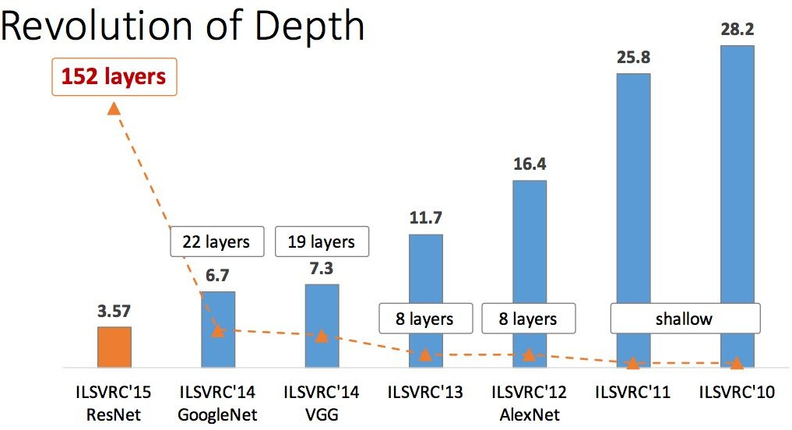
ImageNet Large Scale Visual Recognition Challenge (ILSVRC) winners
First CNN-based winner
Fei-Fei Li & Justin Johnson & Serena Yeung Lecture 9 - May 2, 2017

Slide 32
ImageNet Large Scale Visual Recognition Challenge (ILSVRC) winners
ZFNet: Improved hyperparameters over AlexNet
Fei-Fei Li & Justin Johnson & Serena Yeung Lecture 9 - May 2, 2017

Slide 33
Case Study: ZFNet

Slide 34
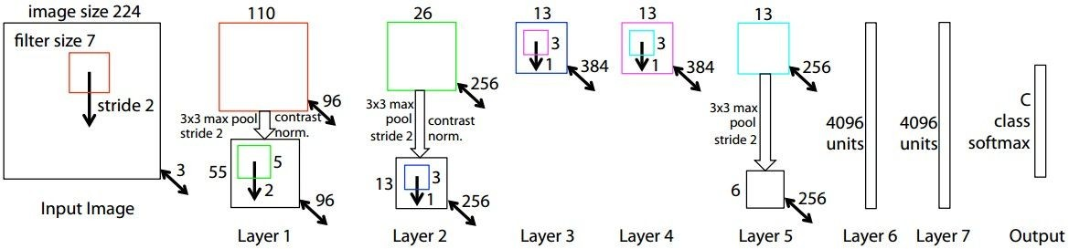
ZFNet
[Zeiler and Fergus, 2013]
TODO: remake figure
AlexNet but:
CONV1: change from (11x11 stride 4) to (7x7 stride 2) CONV3,4,5: instead of 384, 384, 256 filters use 512, 1024, 512
ImageNet top 5 error: 16.4% -> 11.7%
Fei-Fei Li & Justin Johnson & Serena Yeung Lecture 9 - May 2, 2017

Slide 35
ImageNet Large Scale Visual Recognition Challenge (ILSVRC) winners
Deeper Networks
Fei-Fei Li & Justin Johnson & Serena Yeung Lecture 9 - May 2, 2017

Slide 36
Case Study: VGG

Slide 37
Case Study: VGGNet
[Simonyan and Zisserman, 2014]
Softmax
FC 1000
FC 4096
FC 4096
Pool
3x3 conv, 512
3x3 conv, 512
3x3 conv, 512
3x3 conv, 512
Pool
3x3 conv, 512
3x3 conv, 512
3x3 conv, 512
3x3 conv, 512
Pool
3x3 conv, 256
3x3 conv, 256
Pool
3x3 conv, 128
3x3 conv, 128
Pool
3x3 conv, 64
3x3 conv, 64
Input
Softmax
FC 1000
FC 4096
FC 4096
Pool
3x3 conv, 512
3x3 conv, 512
3x3 conv, 512
Pool
3x3 conv, 512
3x3 conv, 512
Small filters, Deeper networks
8 layers (AlexNet)
-> 16 - 19 layers (VGG16Net)
Only 3x3 CONV stride 1, pad 1 and 2x2 MAX POOL stride 2
Softmax
FC 1000
FC 4096
FC 4096
Pool
3x3 conv, 256
3x3 conv, 384
Pool
3x3 conv, 384
Pool
5x5 conv, 256
11x11 conv, 96
Input
3x3 conv, 512
Pool
3x3 conv, 256
3x3 conv, 256
Pool
3x3 conv, 128
3x3 conv, 128
Pool
3x3 conv, 64
3x3 conv, 64
Input
11.7% top 5 error in ILSVRC’13 (ZFNet)
-> 7.3% top 5 error in ILSVRC’14
AlexNet
VGG16
VGG19
Fei-Fei Li & Justin Johnson & Serena Yeung Lecture 9 - May 2, 2017

Slide 38
Case Study: VGGNet
[Simonyan and Zisserman, 2014]
Softmax
FC 1000
FC 4096
FC 4096
Pool
3x3 conv, 512
3x3 conv, 512
3x3 conv, 512
3x3 conv, 512
Pool
3x3 conv, 512
3x3 conv, 512
3x3 conv, 512
3x3 conv, 512
Pool
3x3 conv, 256
3x3 conv, 256
Pool
3x3 conv, 128
3x3 conv, 128
Pool
3x3 conv, 64
3x3 conv, 64
Input
Softmax
FC 1000
FC 4096
FC 4096
Pool
3x3 conv, 512
3x3 conv, 512
3x3 conv, 512
Pool
3x3 conv, 512
3x3 conv, 512
Q: Why use smaller filters? (3x3 conv)
Softmax
FC 1000
FC 4096
FC 4096
Pool
3x3 conv, 256
3x3 conv, 384
Pool
3x3 conv, 384
Pool
5x5 conv, 256
11x11 conv, 96
Input
3x3 conv, 512
Pool
3x3 conv, 256
3x3 conv, 256
Pool
3x3 conv, 128
3x3 conv, 128
Pool
3x3 conv, 64
3x3 conv, 64
Input
AlexNet
VGG16
VGG19
Fei-Fei Li & Justin Johnson & Serena Yeung Lecture 9 - May 2, 2017

Slide 39
Case Study: VGGNet
[Simonyan and Zisserman, 2014]
Softmax
FC 1000
FC 4096
FC 4096
Pool
3x3 conv, 512
3x3 conv, 512
3x3 conv, 512
3x3 conv, 512
Pool
3x3 conv, 512
3x3 conv, 512
3x3 conv, 512
3x3 conv, 512
Pool
3x3 conv, 256
3x3 conv, 256
Pool
3x3 conv, 128
3x3 conv, 128
Pool
3x3 conv, 64
3x3 conv, 64
Input
Softmax
FC 1000
FC 4096
FC 4096
Pool
3x3 conv, 512
3x3 conv, 512
3x3 conv, 512
Pool
3x3 conv, 512
3x3 conv, 512
Q: Why use smaller filters? (3x3 conv)
A: Reducing computational complexity
Softmax
FC 1000
FC 4096
FC 4096
Pool
3x3 conv, 256
3x3 conv, 384
Pool
3x3 conv, 384
Pool
5x5 conv, 256
11x11 conv, 96
Input
3x3 conv, 512
Pool
3x3 conv, 256
3x3 conv, 256
Pool
3x3 conv, 128
3x3 conv, 128
Pool
3x3 conv, 64
3x3 conv, 64
Input
Q: What is the effective receptive field of three 3x3 conv (stride 1) layers?
A: 7x7
AlexNet
VGG16
VGG19
Fei-Fei Li & Justin Johnson & Serena Yeung Lecture 9 - May 2, 2017

Slide 40
Case Study: VGGNet
[Simonyan and Zisserman, 2014]
Softmax
FC 1000
FC 4096
FC 4096
Pool
3x3 conv, 512
3x3 conv, 512
3x3 conv, 512
3x3 conv, 512
Pool
3x3 conv, 512
3x3 conv, 512
3x3 conv, 512
3x3 conv, 512
Pool
3x3 conv, 256
3x3 conv, 256
Pool
3x3 conv, 128
3x3 conv, 128
Pool
3x3 conv, 64
3x3 conv, 64
Input
Softmax
FC 1000
FC 4096
FC 4096
Pool
3x3 conv, 512
3x3 conv, 512
3x3 conv, 512
Pool
3x3 conv, 512
3x3 conv, 512
Q: Why use smaller filters? (3x3 conv)
Stack of three 3x3 conv (stride 1) layers has same effective receptive field as one 7x7 conv layer
But deeper, more non-linearities
Softmax
FC 1000
FC 4096
FC 4096
Pool
3x3 conv, 256
3x3 conv, 384
Pool
3x3 conv, 384
Pool
5x5 conv, 256
11x11 conv, 96
Input
3x3 conv, 512
Pool
3x3 conv, 256
3x3 conv, 256
Pool
3x3 conv, 128
3x3 conv, 128
Pool
3x3 conv, 64
3x3 conv, 64
Input
2 2
And fewer parameters: 3 * (3 C ) vs. 7²C² for C channels per layer
AlexNet
VGG16
VGG19
Fei-Fei Li & Justin Johnson & Serena Yeung Lecture 9 - May 2, 2017

Slide 41
INPUT: [224x224x3] memory: 224*224*3=150K params: 0
CONV3-64: [224x224x64] memory: 224*224*64=3.2M params: (3*3*3)*64 = 1,728 CONV3-64: [224x224x64] memory: 224*224*64=3.2M params: (3*3*64)*64 = 36,864
POOL2: [112x112x64] memory: 112*112*64=800K params: 0
CONV3-128: [112x112x128] memory: 112*112*128=1.6M params: (3*3*64)*128 = 73,728 CONV3-128: [112x112x128] memory: 112*112*128=1.6M params: (3*3*128)*128 = 147,456
POOL2: [56x56x128] memory: 56*56*128=400K params: 0
CONV3-256: [56x56x256] memory: 56*56*256=800K params: (3*3*128)*256 = 294,912 CONV3-256: [56x56x256] memory: 56*56*256=800K params: (3*3*256)*256 = 589,824 CONV3-256: [56x56x256] memory: 56*56*256=800K params: (3*3*256)*256 = 589,824
POOL2: [28x28x256] memory: 28*28*256=200K params: 0
CONV3-512: [28x28x512] memory: 28*28*512=400K params: (3*3*256)*512 = 1,179,648 CONV3-512: [28x28x512] memory: 28*28*512=400K params: (3*3*512)*512 = 2,359,296 CONV3-512: [28x28x512] memory: 28*28*512=400K params: (3*3*512)*512 = 2,359,296
POOL2: [14x14x512] memory: 14*14*512=100K params: 0
CONV3-512: [14x14x512] memory: 14*14*512=100K params: (3*3*512)*512 = 2,359,296 CONV3-512: [14x14x512] memory: 14*14*512=100K params: (3*3*512)*512 = 2,359,296 CONV3-512: [14x14x512] memory: 14*14*512=100K params: (3*3*512)*512 = 2,359,296
POOL2: [7x7x512] memory: 7*7*512=25K params: 0
FC: [1x1x4096] memory: 4096 params: 7*7*512*4096 = 102,760,448 FC: [1x1x4096] memory: 4096 params: 4096*4096 = 16,777,216
FC: [1x1x1000] memory: 1000 params: 4096*1000 = 4,096,000
TOTAL memory: 24M * 4 bytes ~= 96MB / image (only forward! ~*2 for bwd) TOTAL params: 138M parameters
Softmax
FC 1000
FC 4096
FC 4096
Pool
3x3 conv, 512
3x3 conv, 512
3x3 conv, 512
Pool
3x3 conv, 512
3x3 conv, 512
3x3 conv, 512
Pool
3x3 conv, 256
3x3 conv, 256
Pool
3x3 conv, 128
3x3 conv, 128
Pool
3x3 conv, 64
3x3 conv, 64
Input
VGG16
(not counting biases)!!
Fei-Fei Li & Justin Johnson & Serena Yeung Lecture 9 - May 2, 2017

Slide 42
Case Study: VGGNet
[Simonyan and Zisserman, 2014]
Softmax
FC 1000
FC 4096
FC 4096
Pool
3x3 conv, 512
3x3 conv, 512
3x3 conv, 512
3x3 conv, 512
Pool
3x3 conv, 512
3x3 conv, 512
3x3 conv, 512
3x3 conv, 512
Pool
3x3 conv, 256
3x3 conv, 256
Pool
3x3 conv, 128
3x3 conv, 128
Pool
3x3 conv, 64
3x3 conv, 64
Input
Softmax
FC 1000
FC 4096
FC 4096
Pool
3x3 conv, 512
3x3 conv, 512
3x3 conv, 512
Pool
3x3 conv, 512
3x3 conv, 512
fc8 fc7 fc6
Details:
conv5-3 conv5-2 conv5-1
ILSVRC’14 2nd in classification, 1st in localization
Similar training procedure as Krizhevsky 2012
No Local Response Normalisation (LRN)
Use VGG16 or VGG19 (VGG19 only slightly better, more memory)
Use ensembles for best results
FC7 features generalize well to other tasks
Softmax
FC 1000
FC 4096
FC 4096
Pool
3x3 conv, 256
3x3 conv, 384
Pool
3x3 conv, 384
Pool
5x5 conv, 256
11x11 conv, 96
Input
conv4-3 conv4-2 conv4-1
fc7 fc6
3x3 conv, 512
Pool
3x3 conv, 256
3x3 conv, 256
Pool
3x3 conv, 128
3x3 conv, 128
Pool
3x3 conv, 64
3x3 conv, 64
Input
conv3-2 conv3-1
conv5 conv4
conv2-2 conv2-1
conv3
conv2 conv1
conv1-2 conv1-1
AlexNet
VGG16
VGG19
Fei-Fei Li & Justin Johnson & Serena Yeung Lecture 9 - May 2, 2017

Slide 43
ImageNet Large Scale Visual Recognition Challenge (ILSVRC) winners
Deeper Networks
Fei-Fei Li & Justin Johnson & Serena Yeung Lecture 9 - May 2, 2017

Slide 44
Case Study: GoogLeNet

Slide 45
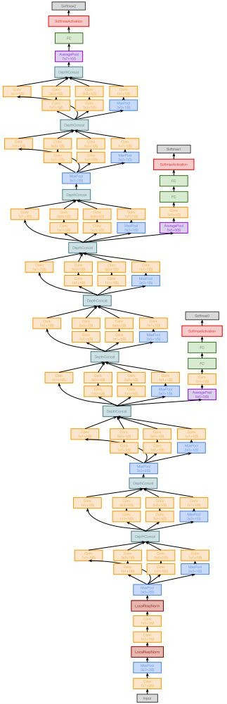
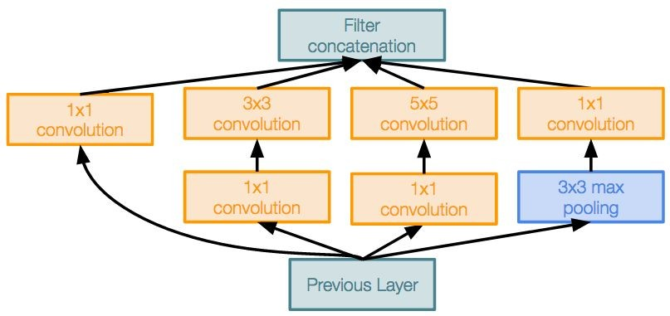
Case Study: GoogLeNet
[Szegedy et al., 2014]
Deeper networks, with computational efficiency
22 layers
Efficient “Inception” module
No FC layers
Only 5 million parameters!
12x less than AlexNet
ILSVRC’14 classification winner (6.7% top 5 error)
Inception module
Fei-Fei Li & Justin Johnson & Serena Yeung Lecture 9 - May 2, 2017

Slide 46
Case Study: GoogLeNet
[Szegedy et al., 2014]
“Inception module”: design a good local network topology (network within a network) and then stack these modules on top of each other
Inception module
Fei-Fei Li & Justin Johnson & Serena Yeung Lecture 9 - May 2, 2017

Slide 47
Case Study: GoogLeNet
[Szegedy et al., 2014]
Apply parallel filter operations on the input from previous layer:
Filter concatenation
Multiple receptive field sizes for convolution (1x1, 3x3, 5x5)
Pooling operation (3x3)
1x1 convolution
3x3 convolution
5x5 convolution
3x3 max pooling
Previous Layer
Concatenate all filter outputs together depth-wise
Naive Inception module
Fei-Fei Li & Justin Johnson & Serena Yeung Lecture 9 - May 2, 2017

Slide 48
Case Study: GoogLeNet
[Szegedy et al., 2014]
Apply parallel filter operations on the input from previous layer:
Filter concatenation
Multiple receptive field sizes for convolution (1x1, 3x3, 5x5)
Pooling operation (3x3)
1x1 convolution
3x3 convolution
5x5 convolution
3x3 max pooling
Previous Layer
Concatenate all filter outputs together depth-wise
Naive Inception module
Q: What is the problem with this? [Hint: Computational complexity]
Fei-Fei Li & Justin Johnson & Serena Yeung Lecture 9 - May 2, 2017

Slide 49
Case Study: GoogLeNet
Q: What is the problem with this? [Hint: Computational complexity]
[Szegedy et al., 2014]
Example:
Q1: What is the output size of the 1x1 conv, with 128 filters?
Filter concatenation
28x28x128
1x1 conv,
128
3x3 conv,
192
5x5 conv,
96
3x3 pool
Module input: 28x28x256
Input
Naive Inception module
Fei-Fei Li & Justin Johnson & Serena Yeung Lecture 9 - May 2, 2017

Slide 50
Case Study: GoogLeNet
Q: What is the problem with this? [Hint: Computational complexity]
[Szegedy et al., 2014]
Example:
Q2: What are the output sizes of all different filter operations?
Filter concatenation
28x28x128
28x28x192 28x28x96
28x28x256
1x1 conv,
128
3x3 conv,
192
5x5 conv,
96
3x3 pool
Module input: 28x28x256
Input
Naive Inception module
Fei-Fei Li & Justin Johnson & Serena Yeung Lecture 9 - May 2, 2017

Slide 51
Case Study: GoogLeNet
Q: What is the problem with this? [Hint: Computational complexity]
[Szegedy et al., 2014]
Example:
Q3:What is output size after filter concatenation?
28x28x(128+192+96+256) = 28x28x672
Filter concatenation
28x28x128
28x28x192 28x28x96
28x28x256
1x1 conv,
128
3x3 conv,
192
5x5 conv,
96
3x3 pool
Module input: 28x28x256
Input
Naive Inception module
Fei-Fei Li & Justin Johnson & Serena Yeung Lecture 9 - May 2, 2017

Slide 52
Case Study: GoogLeNet
Q: What is the problem with this? [Hint: Computational complexity]
[Szegedy et al., 2014]
Example:
Q3:What is output size after filter concatenation?
Conv Ops:
[1x1 conv, 128] 28x28x128x1x1x256 [3x3 conv, 192] 28x28x192x3x3x256 [5x5 conv, 96] 28x28x96x5x5x256 Total: 854M ops
28x28x(128+192+96+256) = 28x28x672
Filter concatenation
28x28x128
28x28x192 28x28x96
28x28x256
1x1 conv,
128
3x3 conv,
192
5x5 conv,
96
3x3 pool
Module input: 28x28x256
Input
Naive Inception module
Fei-Fei Li & Justin Johnson & Serena Yeung Lecture 9 - May 2, 2017

Slide 53
Case Study: GoogLeNet
Q: What is the problem with this? [Hint: Computational complexity]
[Szegedy et al., 2014]
Example:
Q3:What is output size after filter concatenation?
Conv Ops:
[1x1 conv, 128] 28x28x128x1x1x256 [3x3 conv, 192] 28x28x192x3x3x256 [5x5 conv, 96] 28x28x96x5x5x256 Total: 854M ops
28x28x(128+192+96+256) = 28x28x672
Filter concatenation
28x28x128
28x28x192 28x28x96
28x28x256
1x1 conv,
128
3x3 conv,
192
5x5 conv,
96
3x3 pool
Very expensive compute
Module input: 28x28x256
Input
Pooling layer also preserves feature depth, which means total depth after concatenation can only grow at every layer!
Naive Inception module
Fei-Fei Li & Justin Johnson & Serena Yeung Lecture 9 - May 2, 2017

Slide 54
Case Study: GoogLeNet
Q: What is the problem with this? [Hint: Computational complexity]
[Szegedy et al., 2014]
Example:
Q3:What is output size after filter concatenation?
28x28x(128+192+96+256) = 529k
Solution: “bottleneck” layers that use 1x1 convolutions to reduce feature depth
Filter concatenation
28x28x128
28x28x192 28x28x96
28x28x256
1x1 conv,
128
3x3 conv,
192
5x5 conv,
96
3x3 pool
Module input: 28x28x256
Input
Naive Inception module
Fei-Fei Li & Justin Johnson & Serena Yeung Lecture 9 - May 2, 2017

Slide 55
Reminder: 1x1 convolutions
1x1 CONV
with 32 filters
56
56
(each filter has size 1x1x64, and performs a 64-dimensional dot product)
56
56
64
32
Fei-Fei Li & Justin Johnson & Serena Yeung Lecture 9 - May 2, 2017

Slide 56
Reminder: 1x1 convolutions
1x1 CONV
with 32 filters
56
56
preserves spatial dimensions, reduces depth!
56
Projects depth to lower dimension (combination of feature maps)
56
64
32
Fei-Fei Li & Justin Johnson & Serena Yeung Lecture 9 - May 2, 2017

Slide 57
Case Study: GoogLeNet
[Szegedy et al., 2014]
Filter concatenation
Filter concatenation
1x1 convolution
3x3 convolution
5x5 convolution
3x3 max pooling
1x1 convolution
3x3 convolution
5x5 convolution
1x1 convolution
1x1 convolution
1x1 convolution
3x3 max pooling
Previous Layer
Previous Layer
Naive Inception module
Inception module with dimension reduction
Fei-Fei Li & Justin Johnson & Serena Yeung Lecture 9 - May 2, 2017

Slide 58
Case Study: GoogLeNet
[Szegedy et al., 2014]
1x1 conv “bottleneck” layers
Filter concatenation
Filter concatenation
1x1 convolution
3x3 convolution
5x5 convolution
3x3 max pooling
1x1 convolution
3x3 convolution
5x5 convolution
1x1 convolution
1x1 convolution
1x1 convolution
3x3 max pooling
Previous Layer
Previous Layer
Naive Inception module
Inception module with dimension reduction
Fei-Fei Li & Justin Johnson & Serena Yeung Lecture 9 - May 2, 2017

Slide 59
Case Study: GoogLeNet
[Szegedy et al., 2014]
Using same parallel layers as naive example, and adding “1x1 conv, 64 filter” bottlenecks:
28x28x480
Conv Ops:
[1x1 conv, 64] 28x28x64x1x1x256 [1x1 conv, 64] 28x28x64x1x1x256 [1x1 conv, 128] 28x28x128x1x1x256 [3x3 conv, 192] 28x28x192x3x3x64 [5x5 conv, 96] 28x28x96x5x5x64 [1x1 conv, 64] 28x28x64x1x1x256 Total: 358M ops
Filter concatenation
28x28x128
28x28x192 28x28x96
28x28x64
1x1 conv,
128
3x3 conv,
192
5x5 conv,
96
1x1 conv,
64
28x28x64
28x28x64
28x28x256
1x1 conv, 64
1x1 conv, 64
3x3 pool
Module input: 28x28x256
Previous Layer
Compared to 854M ops for naive version Bottleneck can also reduce depth after pooling layer
Inception module with dimension reduction
Fei-Fei Li & Justin Johnson & Serena Yeung Lecture 9 - May 2, 2017

Slide 60
Case Study: GoogLeNet
[Szegedy et al., 2014]
Stack Inception modules with dimension reduction on top of each other
Inception module
Fei-Fei Li & Justin Johnson & Serena Yeung Lecture 9 - May 2, 2017

Slide 61

Case Study: GoogLeNet
[Szegedy et al., 2014]
Full GoogLeNet architecture
Stem Network: Conv-Pool- 2x Conv-Pool
Fei-Fei Li & Justin Johnson & Serena Yeung Lecture 9 - May 2, 2017

Slide 62
Case Study: GoogLeNet
[Szegedy et al., 2014]
Full GoogLeNet architecture
Stacked Inception Modules
Fei-Fei Li & Justin Johnson & Serena Yeung Lecture 9 - May 2, 2017

Slide 63
Case Study: GoogLeNet
[Szegedy et al., 2014]
Full GoogLeNet architecture
Classifier output
Fei-Fei Li & Justin Johnson & Serena Yeung Lecture 9 - May 2, 2017

Slide 64
Case Study: GoogLeNet
[Szegedy et al., 2014]
Full GoogLeNet architecture
Classifier output (removed expensive FC layers!)
Fei-Fei Li & Justin Johnson & Serena Yeung Lecture 9 - May 2, 2017

Slide 65
Case Study: GoogLeNet
[Szegedy et al., 2014]
Full GoogLeNet architecture
Auxiliary classification outputs to inject additional gradient at lower layers (AvgPool-1x1Conv-FC-FC-Softmax)
Fei-Fei Li & Justin Johnson & Serena Yeung Lecture 9 - May 2, 2017

Slide 66
Case Study: GoogLeNet
[Szegedy et al., 2014]
Full GoogLeNet architecture
22 total layers with weights (including each parallel layer in an Inception module)
Fei-Fei Li & Justin Johnson & Serena Yeung Lecture 9 - May 2, 2017

Slide 67
Case Study: GoogLeNet
[Szegedy et al., 2014]
Deeper networks, with computational efficiency
22 layers
Efficient “Inception” module
No FC layers
12x less params than AlexNet
ILSVRC’14 classification winner (6.7% top 5 error)
Inception module
Fei-Fei Li & Justin Johnson & Serena Yeung Lecture 9 - May 2, 2017

Slide 68
ImageNet Large Scale Visual Recognition Challenge (ILSVRC) winners
“Revolution of Depth”
Fei-Fei Li & Justin Johnson & Serena Yeung Lecture 9 - May 2, 2017

Slide 69
Case Study: ResNet

Slide 70
Case Study: ResNet
[He et al., 2015]
Softmax
FC 1000
Pool
3x3 conv, 64
3x3 conv, 64
relu
3x3 conv, 64
Very deep networks using residual connections
3x3 conv, 64
F(x) + x
3x3 conv, 64
3x3 conv, 64
..
.
conv
152-layer model for ImageNet
ILSVRC’15 classification winner (3.57% top 5 error)
Swept all classification and detection competitions in ILSVRC’15 and COCO’15!
3x3 conv, 128
F(x)
X
identity
3x3 conv, 128
relu
3x3 conv, 128
conv
3x3 conv, 128
3x3 conv, 128
3x3 conv, 128 / 2
3x3 conv, 64
X
Residual block
3x3 conv, 64
3x3 conv, 64
3x3 conv, 64
3x3 conv, 64
3x3 conv, 64
Pool
7x7 conv, 64 / 2
Input
Fei-Fei Li & Justin Johnson & Serena Yeung Lecture 9 - May 2, 2017

Slide 71
Case Study: ResNet
[He et al., 2015]
What happens when we continue stacking deeper layers on a “plain” convolutional neural network?
Fei-Fei Li & Justin Johnson & Serena Yeung Lecture 9 - May 2, 2017

Slide 72
Case Study: ResNet
[He et al., 2015]
What happens when we continue stacking deeper layers on a “plain” convolutional neural network?
56-layer
Training error
56-layer
Test error
20-layer
20-layer
Iterations
Iterations
Q: What’s strange about these training and test curves? [Hint: look at the order of the curves]
Fei-Fei Li & Justin Johnson & Serena Yeung Lecture 9 - May 2, 2017

Slide 73
Case Study: ResNet
[He et al., 2015]
What happens when we continue stacking deeper layers on a “plain” convolutional neural network?
56-layer
Training error
56-layer
Test error
20-layer
20-layer
Iterations
Iterations
56-layer model performs worse on both training and test error
-> The deeper model performs worse, but it’s not caused by overfitting!
Fei-Fei Li & Justin Johnson & Serena Yeung Lecture 9 - May 2, 2017

Slide 74
Case Study: ResNet
[He et al., 2015]
Hypothesis: the problem is an optimization problem, deeper models are harder to optimize
Fei-Fei Li & Justin Johnson & Serena Yeung Lecture 9 - May 2, 2017

Slide 75
Case Study: ResNet
[He et al., 2015]
Hypothesis: the problem is an optimization problem, deeper models are harder to optimize
The deeper model should be able to perform at least as well as the shallower model.
A solution by construction is copying the learned layers from the shallower model and setting additional layers to identity mapping.
Fei-Fei Li & Justin Johnson & Serena Yeung Lecture 9 - May 2, 2017

Slide 76
Case Study: ResNet
[He et al., 2015]
Solution: Use network layers to fit a residual mapping instead of directly trying to fit a desired underlying mapping
H(x) = F(x) + x
relu
H(x)
F(x) + x
Use layers to fit residual F(x) = H(x) - x
instead of H(x) directly
conv
conv
F(x)
X
identity
 | relu
conv
relu
conv
X
“Plain” layers
X
Residual block
Fei-Fei Li & Justin Johnson & Serena Yeung Lecture 9 - May 2, 2017

Slide 77
Case Study: ResNet
[He et al., 2015]
Softmax
FC 1000
Pool
3x3 conv, 512
3x3 conv, 512
Full ResNet architecture:
3x3 conv, 512
3x3 conv, 512
Stack residual blocks
Every residual block has two 3x3 conv layers
relu
3x3 conv, 512
F(x) + x
3x3 conv, 512, /2
..
.
3x3 conv
3x3 conv, 128
3x3 conv, 128
F(x)
X
identity
3x3 conv, 128
relu
3x3 conv, 128
3x3 conv
3x3 conv, 128
3x3 conv, 128, / 2
3x3 conv, 64
3x3 conv, 64
X
Residual block
3x3 conv, 64
3x3 conv, 64
3x3 conv, 64
3x3 conv, 64
Pool
7x7 conv, 64, / 2
Input
Fei-Fei Li & Justin Johnson & Serena Yeung Lecture 9 - May 2, 2017

Slide 78
Case Study: ResNet
[He et al., 2015]
Softmax
FC 1000
Pool
3x3 conv, 512
3x3 conv, 512
Full ResNet architecture:
3x3 conv, 512
3x3 conv, 512
Stack residual blocks
Every residual block has two 3x3 conv layers
Periodically, double # of filters and downsample spatially using stride 2 (/2 in each dimension)
relu
3x3 conv, 512
F(x) + x
3x3 conv, 512, /2
..
.
3x3 conv
3x3 conv, 128
3x3 conv, 128
3x3 conv, 128 filters, /2 spatially with stride 2
F(x)
X
identity
3x3 conv, 128
relu
3x3 conv, 128
3x3 conv
3x3 conv, 128
3x3 conv, 128, / 2
3x3 conv, 64
3x3 conv, 64 filters
3x3 conv, 64
X
Residual block
3x3 conv, 64
3x3 conv, 64
3x3 conv, 64
3x3 conv, 64
Pool
7x7 conv, 64, / 2
Input
Fei-Fei Li & Justin Johnson & Serena Yeung Lecture 9 - May 2, 2017

Slide 79
Case Study: ResNet
[He et al., 2015]
Softmax
FC 1000
Pool
3x3 conv, 512
3x3 conv, 512
Full ResNet architecture:
3x3 conv, 512
3x3 conv, 512
Stack residual blocks
Every residual block has two 3x3 conv layers
Periodically, double # of filters and downsample spatially using stride 2 (/2 in each dimension)
Additional conv layer at the beginning
relu
3x3 conv, 512
F(x) + x
3x3 conv, 512, /2
..
.
3x3 conv
3x3 conv, 128
3x3 conv, 128
F(x)
X
identity
3x3 conv, 128
relu
3x3 conv, 128
3x3 conv
3x3 conv, 128
3x3 conv, 128, / 2
3x3 conv, 64
3x3 conv, 64
X
Residual block
3x3 conv, 64
3x3 conv, 64
3x3 conv, 64
3x3 conv, 64
Pool
7x7 conv, 64, / 2
Input
Beginning conv layer
Fei-Fei Li & Justin Johnson & Serena Yeung Lecture 9 - May 2, 2017

Slide 80
Case Study: ResNet
[He et al., 2015]
Softmax
FC 1000
Pool
No FC layers
besides FC 1000 to output classes
3x3 conv, 512
3x3 conv, 512
Full ResNet architecture:
3x3 conv, 512
3x3 conv, 512
Global average pooling layer after last conv layer
Stack residual blocks
Every residual block has two 3x3 conv layers
Periodically, double # of filters and downsample spatially using stride 2 (/2 in each dimension)
Additional conv layer at the beginning
No FC layers at the end (only FC 1000 to output classes)
relu
3x3 conv, 512
F(x) + x
3x3 conv, 512, /2
..
.
3x3 conv
3x3 conv, 128
3x3 conv, 128
F(x)
X
identity
3x3 conv, 128
relu
3x3 conv, 128
3x3 conv
3x3 conv, 128
3x3 conv, 128, / 2
3x3 conv, 64
3x3 conv, 64
X
Residual block
3x3 conv, 64
3x3 conv, 64
3x3 conv, 64
3x3 conv, 64
Pool
7x7 conv, 64, / 2
Input
Fei-Fei Li & Justin Johnson & Serena Yeung Lecture 9 - May 2, 2017

Slide 81
Case Study: ResNet
[He et al., 2015]
Softmax
FC 1000
Pool
3x3 conv, 512
3x3 conv, 512
3x3 conv, 512
3x3 conv, 512
3x3 conv, 512
Total depths of 34, 50, 101, or 152 layers for ImageNet
3x3 conv, 512, /2
..
.
3x3 conv, 128
3x3 conv, 128
3x3 conv, 128
3x3 conv, 128
3x3 conv, 128
3x3 conv, 128, / 2
3x3 conv, 64
3x3 conv, 64
3x3 conv, 64
3x3 conv, 64
3x3 conv, 64
3x3 conv, 64
Pool
7x7 conv, 64, / 2
Input
Fei-Fei Li & Justin Johnson & Serena Yeung Lecture 9 - May 2, 2017

Slide 82

Case Study: ResNet
[He et al., 2015]
28x28x256
output
For deeper networks
(ResNet-50+), use “bottleneck” layer to improve efficiency (similar to GoogLeNet)
1x1 conv, 256
3x3 conv, 64
1x1 conv, 64
28x28x256
input
Fei-Fei Li & Justin Johnson & Serena Yeung Lecture 9 - May 2, 2017

Slide 83
Case Study: ResNet
[He et al., 2015]
28x28x256
output
1x1 conv, 256 filters projects
back to 256 feature maps (28x28x256)
For deeper networks
(ResNet-50+), use “bottleneck” layer to improve efficiency (similar to GoogLeNet)
1x1 conv, 256
3x3 conv operates over only 64 feature maps
3x3 conv, 64
1x1 conv, 64 filters to project to 28x28x64
1x1 conv, 64
28x28x256
input
Fei-Fei Li & Justin Johnson & Serena Yeung Lecture 9 - May 2, 2017

Slide 84
Case Study: ResNet
[He et al., 2015]
Training ResNet in practice:
Batch Normalization after every CONV layer
Xavier/2 initialization from He et al.
SGD + Momentum (0.9)
Learning rate: 0.1, divided by 10 when validation error plateaus
Mini-batch size 256
Weight decay of 1e-5
No dropout used
Fei-Fei Li & Justin Johnson & Serena Yeung Lecture 9 - May 2, 2017

Slide 85

Case Study: ResNet
[He et al., 2015]
Experimental Results
Able to train very deep networks without degrading (152 layers on ImageNet, 1202 on Cifar)
Deeper networks now achieve lowing training error as expected
Swept 1st place in all ILSVRC and COCO 2015 competitions
Fei-Fei Li & Justin Johnson & Serena Yeung Lecture 9 - May 2, 2017

Slide 86
Case Study: ResNet
[He et al., 2015]
Experimental Results
Able to train very deep networks without degrading (152 layers on ImageNet, 1202 on Cifar)
Deeper networks now achieve lowing training error as expected
Swept 1st place in all ILSVRC and COCO 2015 competitions
ILSVRC 2015 classification winner (3.6% top 5 error) -- better than “human performance”! (Russakovsky 2014)
Fei-Fei Li & Justin Johnson & Serena Yeung Lecture 9 - May 2, 2017

Slide 87
ImageNet Large Scale Visual Recognition Challenge (ILSVRC) winners
Fei-Fei Li & Justin Johnson & Serena Yeung Lecture 9 - May 2, 2017

Slide 88
Comparisons

Slide 89

Comparing complexity...
An Analysis of Deep Neural Network Models for Practical Applications, 2017.
Figures copyright Alfredo Canziani, Adam Paszke, Eugenio Culurciello, 2017. Reproduced with permission.
Fei-Fei Li & Justin Johnson & Serena Yeung Lecture 9 - May 2, 2017

Slide 90
Comparing complexity...
Inception-v4: Resnet + Inception!
An Analysis of Deep Neural Network Models for Practical Applications, 2017.
Figures copyright Alfredo Canziani, Adam Paszke, Eugenio Culurciello, 2017. Reproduced with permission.
Fei-Fei Li & Justin Johnson & Serena Yeung Lecture 9 - May 2, 2017

Slide 91
Comparing complexity...
VGG: Highest memory, most operations
An Analysis of Deep Neural Network Models for Practical Applications, 2017.
Figures copyright Alfredo Canziani, Adam Paszke, Eugenio Culurciello, 2017. Reproduced with permission.
Fei-Fei Li & Justin Johnson & Serena Yeung Lecture 9 - May 2, 2017

Slide 92
GoogLeNet: most efficient
Comparing complexity...
An Analysis of Deep Neural Network Models for Practical Applications, 2017.
Figures copyright Alfredo Canziani, Adam Paszke, Eugenio Culurciello, 2017. Reproduced with permission.
Fei-Fei Li & Justin Johnson & Serena Yeung Lecture 9 - May 2, 2017

Slide 93
AlexNet:
Smaller compute, still memory heavy, lower accuracy
Comparing complexity...
An Analysis of Deep Neural Network Models for Practical Applications, 2017.
Figures copyright Alfredo Canziani, Adam Paszke, Eugenio Culurciello, 2017. Reproduced with permission.
Fei-Fei Li & Justin Johnson & Serena Yeung Lecture 9 - May 2, 2017

Slide 94
Comparing complexity...
An Analysis of Deep Neural Network Models for Practical Applications, 2017.
Figures copyright Alfredo Canziani, Adam Paszke, Eugenio Culurciello, 2017. Reproduced with permission.
Fei-Fei Li & Justin Johnson & Serena Yeung Lecture 9 - May 2, 2017

Slide 95

Forward pass time and power consumption
An Analysis of Deep Neural Network Models for Practical Applications, 2017.
Figures copyright Alfredo Canziani, Adam Paszke, Eugenio Culurciello, 2017. Reproduced with permission.
Fei-Fei Li & Justin Johnson & Serena Yeung Lecture 9 - May 2, 2017

Slide 96
Other architectures to know...

Slide 97


Network in Network (NiN)
[Lin et al. 2014]
Mlpconv layer with “micronetwork” within each conv layer to compute more abstract features for local patches
Micronetwork uses multilayer perceptron (FC, i.e. 1x1 conv layers)
Precursor to GoogLeNet and ResNet “bottleneck” layers
Philosophical inspiration for GoogLeNet
Figures copyright Lin et al., 2014. Reproduced with permission.

Slide 98

Improving ResNets...
Identity Mappings in Deep Residual Networks
[He et al. 2016]
Improved ResNet block design from creators of ResNet
Creates a more direct path for propagating information throughout network (moves activation to residual mapping pathway)
Gives better performance
conv
ReLU
BN
conv
ReLU
BN

Slide 99
Improving ResNets...
Wide Residual Networks
[Zagoruyko et al. 2016]
Argues that residuals are the important factor, not depth
User wider residual blocks (F x k filters instead of F filters in each layer)
50-layer wide ResNet outperforms 152-layer original ResNet
Increasing width instead of depth more computationally efficient (parallelizable)
3x3 conv, F
3x3 conv, F x k
3x3 conv, F
3x3 conv, F x k
Basic residual block
Wide residual block

Slide 100



Improving ResNets...
Aggregated Residual Transformations for Deep
Neural Networks (ResNeXt)
[Xie et al. 2016]
256-d out
Also from creators of ResNet
Increases width of residual block through multiple parallel pathways (“cardinality”)
Parallel pathways similar in spirit to Inception module
256-d out
1x1 conv, 256
1x1 conv, 256
1x1 conv, 256
1x1 conv, 256
32
3x3 conv, 64
3x3 conv, 4
3x3 conv, 4
paths
3x3 conv, 4
...
1x1 conv, 64
1x1 conv, 4
1x1 conv, 4
1x1 conv, 4
256-d in
256-d in

Slide 101
Improving ResNets...
Deep Networks with Stochastic Depth
[Huang et al. 2016]
Motivation: reduce vanishing gradients and training time through short networks during training
Randomly drop a subset of layers during each training pass
Bypass with identity function
Use full deep network at test time

Slide 102

Beyond ResNets...
FractalNet: Ultra-Deep Neural Networks without Residuals
[Larsson et al. 2017]
Argues that key is transitioning effectively from shallow to deep and residual representations are not necessary
Fractal architecture with both shallow and deep paths to output
Trained with dropping out sub-paths
Full network at test time
Figures copyright Larsson et al., 2017. Reproduced with permission.

Slide 103
Beyond ResNets...
Densely Connected Convolutional Networks
Softmax
[Huang et al. 2017]
FC
1x1 conv, 64
Pool
Dense blocks where each layer is connected to every other layer in feedforward fashion
Alleviates vanishing gradient, strengthens feature propagation, encourages feature reuse
Concat
Dense Block 3
Conv
1x1 conv, 64
Pool
Conv
Concat
Dense Block 2
Conv
Conv
Pool
Concat
Conv
Dense Block 1
Conv
Conv
Input
Input
Dense Block
Lecture 9 -
Fei-Fei Li & Justin Johnson & Serena Yeung Lecture 9 - May 2, 2017

Slide 104

Efficient networks...
SqueezeNet: AlexNet-level Accuracy With 50x Fewer Parameters and <0.5Mb Model Size
[Iandola et al. 2017]
Fire modules consisting of a ‘squeeze’ layer with 1x1 filters feeding an ‘expand’ layer with 1x1 and 3x3 filters
AlexNet level accuracy on ImageNet with 50x fewer parameters
Can compress to 510x smaller than AlexNet (0.5Mb)
Figure copyright Iandola, Han, Moskewicz, Ashraf, Dally, Keutzer, 2017. Reproduced with permission.
Lecture 9 -
Fei-Fei Li & Justin Johnson & Serena Yeung Lecture 9 - May 2, 2017

Slide 105



Case Study Bonus: DeepMind’s AlphaGo

Slide 106
Summary: CNN Architectures
Case Studies
AlexNet
VGG
GoogLeNet
ResNet
Also....
NiN (Network in Network)
Wide ResNet
ResNeXT
Stochastic Depth
DenseNet
FractalNet
SqueezeNet
Fei-Fei Li & Justin Johnson & Serena Yeung
Lecture 9 - ¹⁰
May 2, 2017
0

